Slide 1
APEC – TSUKUBA International Conference on Mathematics Education in the Future 11 – 13 February 2015 Tokyo, Japan “Lesson Study in Thailand : Experiences and Challenges”
Professor Dr. Kanok Wongtrangan
Khon Kaen University
Thailand

Slide 2
Mathematics Education in the 21st Century
From static discipline to an open – ended search for pattern
Begin with number and shape then expand into optimization, control theory and so on
No longer the language of Natural Sciences but also Human Sciences
Fundamental Changes of Mathematics Education

Slide 3
Mathematics Education in the 21st Century
Teach students to understand Mathematics and to do Mathematics
Teach students to see and reveal hidden patterns of numbers, problems, and the like in their everyday life and their professional tasks.
Mathematics Education must develop student’s ability and skills to walk through school, university, work place, and daily living environments.

Slide 4
Mathematics Education in the 21st Century
Mathematics Education must open doors to students to an endless journey of the Future
Mathematics Education must prepare students to manage the change and uncertainty of the Future

Slide 5
Lesson Study and Challenges
Lesson Study is a valid and right approach of Mathematics Education in the 21st Century
Lesson Study teaches students to learn Mathematics of the Future
Ability to search for “Patterns” in complexities
Ability to see regularity and interconnections of unorganized complexity

Slide 6
Lesson Study in Thailand : Experiences and Challenges
2002 – 2008 : From class room to whole school
2008 – 2014 : Expand to 60 schools
2015 – 2020 : Scale up to 600 schools
Results indicated by high performance and motivation of students participated

Slide 7
O-NET Scores

Slide 8
Practical Experiences of Thailand
Approach
Develop understanding, acceptance, and practice of Lesson Study in selected classrooms and schools
Replicate its success to other schools

Slide 9
Practical Experiences of Thailand
Obstacles and Problems
Low competent teachers (knowledge and experience on Lesson Study)
School Principals have no confidence in Lesson Study
Textbook, Teacher’s Guidebook and related equipment and support not completely available
9

Slide 10
Critical Success Factors
Quality Teachers
Knowledge on Mathematics
Knowledge on Mathematical Pedagogy
Motivation to teach (Mind Set)
Supports from
School Principal
Faculty of Education, Khon Kaen University
Policy Makers at national level

Slide 11
Challenges of Lesson Study in Thailand
7 Millions students
30,000 schools
400,000 teachers
Scaleability is the key to the Future

Slide 12
Scaleability Plan of Lesson Study in Thailand
Develop critical infrastructure
Establish “In-Service” teacher training institute at KKU
Revitalize “Pre-Service” teacher training program at Faculty of Education, KKU
Accelerate production of Textbook, Teacher Guidebook, and related teaching equipment
Upgrade and expand Supervision system

Slide 13
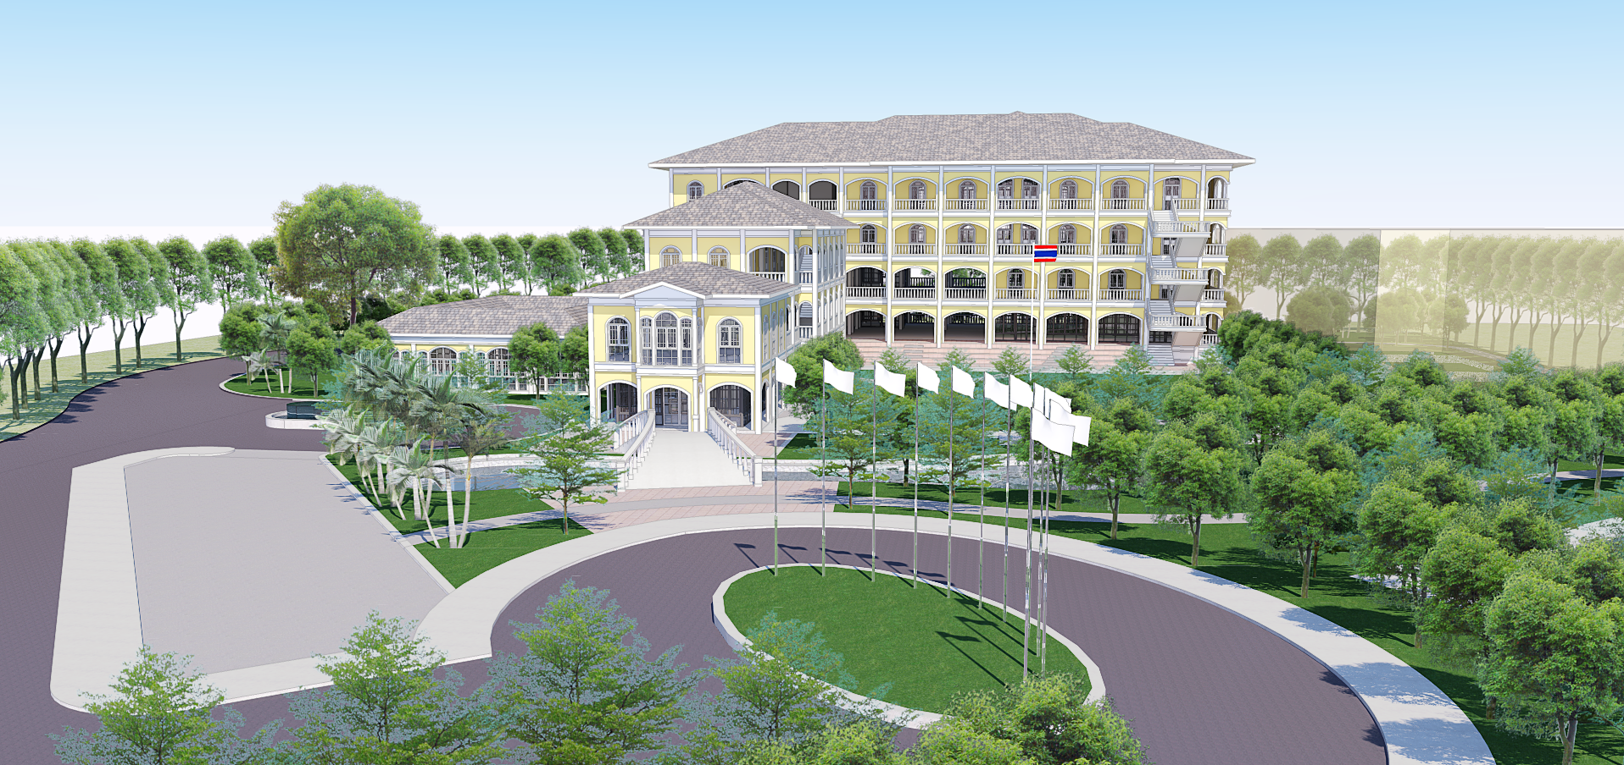

Slide 14
Scaleability Plan of Lesson Study
in Thailand
Dialogue with Policy Makers
To ensure continuity of support and commitment
To reform Mathematics Curriculum and Quality Assessment System

Slide 15
Scaleability Plan of Lesson Study
in Thailand
Develop Expansion Nodes and their capacities to cover target areas
Develop Core Team to support scale up activities
Establish Help Desk and IT support
Set up Training programs
Classroom Supervision system must be ready

Slide 16
Challenges of Lesson Study in APEC Countries
More than 200 Millions students in APEC countries need Lesson Study
The best we can do now is 2 Millions per year (Estimation)
It will take 100 years to cover needed students
Scaleability Methodology and System of Lesson Study in APEC countries is urgently needed

Slide 17
Critical Success Factor for Scaleability in APEC Countries
Lesson Study as a technical solution to future Mathematics Education is available
Scaleability of Lesson Study is urgent and must be a critical Regional Agenda of APEC
This Regional Agenda needs to be placed in the next APEC Leaders Meeting

Slide 18
Final Reflection
Keith Devlin
“In the natural sciences, mathematics is the absolute ruler. If you break the mathematical rules, you are no longer doing physics, or astronomy, or whatever. But in the human sciences, mathematics is just a tool.”

Slide 19
Final Reflection
Soumen Akatemia
“[Mathematic Education needs] new pedagogical practices and technological environments that will inspire students to observe quantitative relationships in their everyday surroundings.”

Slide 20
Final Reflection
Lynn Steen
“The key issue for mathematics education is not whether to teach fundamentals but which fundamentals to teach and how to teach them.”

Slide 21
Final Reflection
Thus, we, as Lesson Study promoters, need to
Review mistakes in the Past
Analyze success at the Present
Imagine problems and challenges in the Future
Then, You will be the True Leader of Lesson Study.

Slide 22
Final Reflection
Yes, Together We Can

Slide 23
THANK YOU

